Slide 1


Introduction to Databases

Slide 2

Databases
It is important for all software developers to be able to access, manipulate and store data.
Database: a large container of data, with the ability to order the data in multiple ways while providing easy access to the data itself.
Notes:
Web developers often have to manipulate the data stored in databases. For example, you may need to store your users’ usernames, passwords, names, addresses and telephone numbers, etc. Therefore, full stack web developers need to be able to work proficiently with databases.

Slide 3
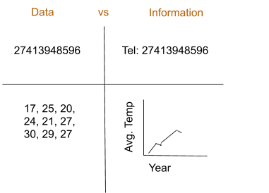
Data vs. Information
Data: raw, unprocessed facts
Information: the result of processing the raw data to reveal its meaning
Notes:
The production of accurate, relevant and timely information is the key to good decision-making and, in turn, good decision-making is the key to a business’ survival in a global environment. Timely and useful information requires accurate data which must be generated properly and stored in a format that is easy to access and process. The data environment should be carefully managed.

Slide 4
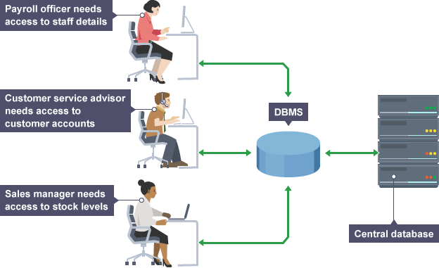
DBMS
Database Management System: a collection of programs that manage the database structure and controls access to the data stored in the database.
The DBMS manages the interaction between the end user and the database (bbc.co.uk)
Notes:
The illustration above shows how the DBMS serves as an intermediary between the user and the database. The DBMS receives all application requests and translates them into the complex operations required to fulfil those requests.
Much of the database’s internal complexity is hidden from the application programs and end users by the DBMS. There are some very important advantages to having a DBMS between the end user’s application and the database. Firstly, the DBMS allows the data in the database to be shared among multiple applications or users. Secondly, the DBMS integrates many different users’ views of the data into a single data repository.

Slide 5
DBMS
DBMS helps make data management more efficient and effective and provides advantages:
Improved data sharing
Better data integration
Minimized data inconsistency
Improved data access
Improved decision-making
Increased end user productivity
Notes:
Improved data sharing: The DBMS helps create an environment in which end users have better access to more and better-managed data.
Better data integration: An integrated view of the organisation’s operations and a clearer view of the big picture is promoted by wider access to well-managed data.
Minimised data inconsistency: Data inconsistency occurs when different versions of the same data appear in different places. A properly designed database greatly reduces the probability of data inconsistency.
Improved data access: A query is a specific request for data manipulation (e.g. to read or update the data) sent to the DBMS. The DBMS makes it possible to produce quick answers to spur-of-the-moment queries.
Improved decision-making: Better-quality information (on which decisions are made) is generated, due to better-managed data and improved data access.
Increased end user productivity: The availability of data and the tools that transform data into usable information encourage end users to make quick, informed decisions.

Slide 6
Types of Databases: Based on users supported
Single-user: only supports one user at a time
Multi-user: supports a relatively small number of users (usually less than 50) or a specific department within an organisation
Enterprise: supports many users (more than 50) and is used by the entire organisation, across many departments
Notes:
With a single user database, if user A is using the database, users B and C must wait until user A is done. A desktop database is a single-user database that runs on a personal computer.
A multi-user database, on the other hand, supports multiple users at the same time. A workgroup database is a multi-user database that supports a relatively small number of users (usually less than 50) or a specific department within an organisation.
When a multi-user database supports many users (more than 50) and is used by the entire organisation, across many departments, it is known as an enterprise database.

Slide 7
Types of Databases: Based on location
Centralized: supports data located at a single site
Distributed: supports data distributed across several different sites.

Slide 8
Types of Databases: How it is used
Operational: designed to primarily support a company’s day-to-day operations. They are also known as online transaction processing (OLTP), transactional or production databases.

Slide 9
Types of Databases: Structure of data
Unstructured: data that exist in their original, or raw, state
Structured: the result of formatting unstructured data to facilitate storage, use and the generation of information
Notes:
You apply structure based on the type of processing that you intend to perform on the data. For example, imagine that you have a stack of printed invoices. If you just want to store these invoices so that you are able to retrieve them or display them later, you can scan them and save them in a graphical format. However, if you what to derive information from them, such as monthly totals or average sales, having the invoices in a graphical format will not be useful. You could instead store the invoice data in a structured spreadsheet format so that you can perform the desired computations.

Slide 10
Types of Databases: Other
Analytical: focus on storing historical data and business metrics used exclusively for tactical or strategic decision making
Typically comprise of two components:
Data warehouse: focuses on storing data used to generate information required to make tactical or strategic decisions
Online analytical processing (OLAP) front end
Relational: organizes data into tables. Links them based on defined relationships that enable you to retrieve/combine data from tables with a single query

Slide 11
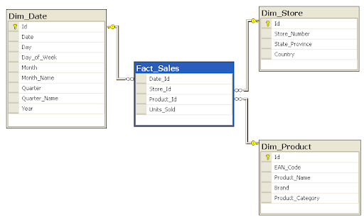
Relational Databases
Image source: https://en.wikipedia.org/wiki/Star_schema#/media/File:Star-schema-example.png
Notes:
Relational databases store information about different entities and the relationship between them. The image below is an example of an entity relationship diagram (ERD) that is used to describe the relationships between certain entities.

Slide 12
Relational Databases
C_NAME | C_PHONE | C_ADDRESS | C_POSTCODE | A_NAME | A_PHONE | TP | AMT | REN
Alfred Smith | 082 345 2341 | 207 Willow St, Port Elizabeth | 6390 | Leah Hahn | 084 259 2073 | T1 | R100.00 | 05-Apr-2021
Kathy Dunne | 083 567 9012 | 556 Bad St, Cape Town | 7100 | Alex Alby | 085 785 3938 | S2 | R250.00 | 16-Jun-2021
Paul Farris | 076 782 1232 | 2148 High St,Benoni | 1522 | Leah Hahn | 084 259 2073 | T2 | R850.00 | 22-sep-2021
Notes:
An entity is a table that stores all the data about a certain thing. For example, you may want to store information about all your customers in a database. You would then create a customer table (customer entity), which could look something like the one shown below:

Slide 13
Relational Databases
C_NAME = customer name
C_PHONE = customer phone
C_ADDRESS = customer address
C_POSTCODE = customer postcode
A_NAME = agent name
A_PHONE = agent phone
TP = insurance type
AMT = insurance policy amount in thousands of R
REN = Insurance renewal date
The CUSTOMER table contains 3 records. Each record is composed of 9 fields: C_NAME, C_PHONE, C_ADDRESS, C_POSTCODE, A_NAME, A_PHONE, TP, AMT and REN. Each record describes a specific customer.
Notes:
If you were designing a database for a store, you might also have a product entity that stores all the information about the products you sell. Your database would then contain a product table and a customer table. The database would also save information about the relationship between the two entities. For example, it would store information about which products a particular customer brought on a particular date. How this is implemented in a relational database, however, is beyond the scope of this course.

Slide 14
NoSQL Databases
NoSQL databases generally have these characteristics:
They are not based on the relational model
They support distributed database architectures i.e. servers in different areas
They provide high scalability, high availability and fault tolerance
They support very large amounts of sparse data
They are geared toward performance rather than transaction consistency
Notes:
A problem with relational databases is that their performance degrades as the volume of data increases. Many web applications have to store massive amounts of data. Imagine the amount of data that companies like Amazon and Google have to store, for example. This has lead to the use of NoSQL databases. You are using a NoSQL database every time you search for a product on Amazon, watch a video on Youtube or send a message to a friend on Facebook.

Slide 15

NoSQL Databases
Key-value store databases:
Img src: https://www.slideshare.net/arangodb/introduction-to-column-oriented-databases
Notes:
Key-value store databases: This is the simplest form of NoSQL database. Every item in the database is stored as a key (used to identify the value) and its value.

Slide 16
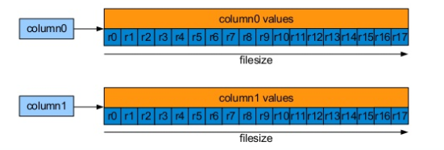
NoSQL Databases
Column-oriented databases:
Img src: https://www.slideshare.net/arangodb/introduction-to-column-oriented-databases
Notes:
Column-oriented databases: Like key-value store databases, a key is used to identify values but instead of the key identifying only one value, it can be used to identify multiple values.

Slide 17
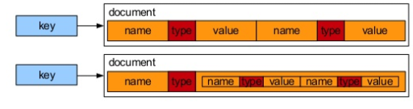
NoSQL Databases
Document store databases:
Img src: https://www.slideshare.net/arangodb/introduction-to-column-oriented-databases
Notes:
Document store databases: With this type of database, a key is used to identify a particular document. Documents are stored in recognised formats like XML, JSON, PDF etc.

Slide 18
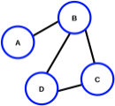
NoSQL Databases
Graph databases:
Object-oriented databases
Notes:
Graph databases: This database uses the graph data structure to store data. Graphs contain nodes (A, B, C and D in the image below) and edges (the lines connecting the nodes). In graph databases, nodes are objects and edges are the relationships between these objects. Social networking applications, like Facebook, often store data using graph databases because it is good at tracking the relationships between objects.
Object-oriented databases: These databases combine OOP and database principles. These databases are tied to specific programming languages.

Slide 19

MongoDB
MongoDB: document store, NoSQL database made up of collections and documents.
Collection: a group of documents. It is similar to an entity or table when working with relational databases.
Documents: In relational databases, records are stored in tables. MongoDB uses BSON (Binary JSON) documents instead of records (or rows in a table) to store data
Notes:
Documents: In relational databases, records are stored in tables. An example of a record in the CUSTOMER table we considered earlier would be Alfred Smith. MongoDB uses documents instead of records (or rows in a table) to store data (i.e. with a MongoDB database, Alfred Smith's data would be stored in a document instead of in a row in the CUSTOMER table). MongoDB uses BSON documents. BSON stands for Binary JSON. BSON uses JSON files and stores type information. JSON files are just text information; this means that it has to be parsed if you want to program with it. Since BSON stores type information it is quicker and more efficient to use than JSON.

Slide 20
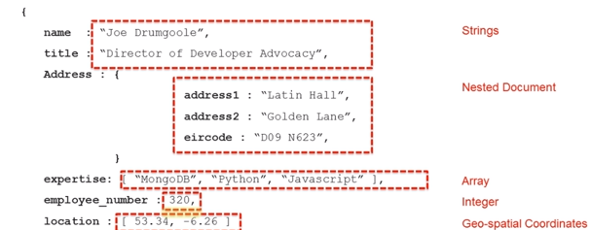
MongoDB

Slide 21
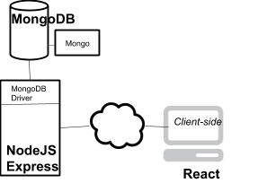
MongoDB in Full Stack Web Application
Notes:
As you already know, to use your app, clients will interact with a web server that will be running Node.js. Node.js will route all requests and perform whatever server-side logic is needed by our app. If our user wants to access, add or change information that needs to be persisted, they will need access to the Database. MongoDB is used for our database. An important component of MongoDB is Mongo. Mongo is MongoDB’s administrative shell. It is a C++ program that allows you to execute instructions on the database from a command line interface. Mongo allows you to use the MongoDB query language.
For Node.js to be able to communicate with MongoDB, it also makes use of MongoDB drivers. The official MongoDB driver can be installed using NPM.

